Slide 1
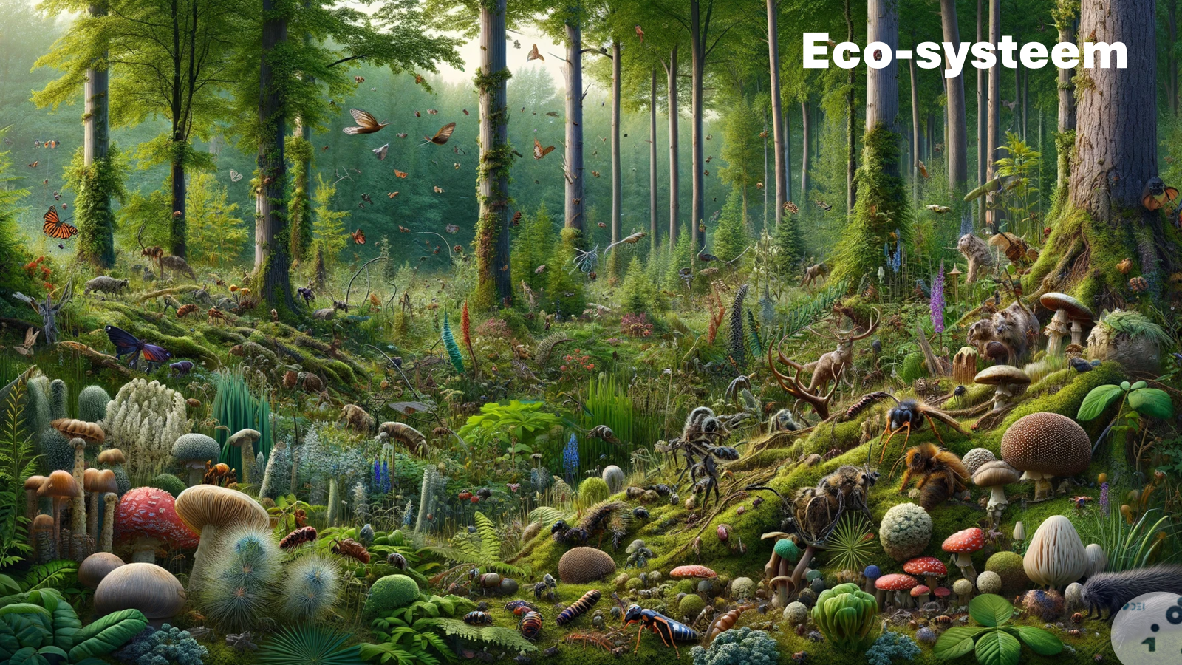
Digital Ecosystems Services Framework
Discover – Strategy – The why of ecosystems
1. Discover
Strategy
The why of
ecosystems
Link naar de presentatie

Slide 2
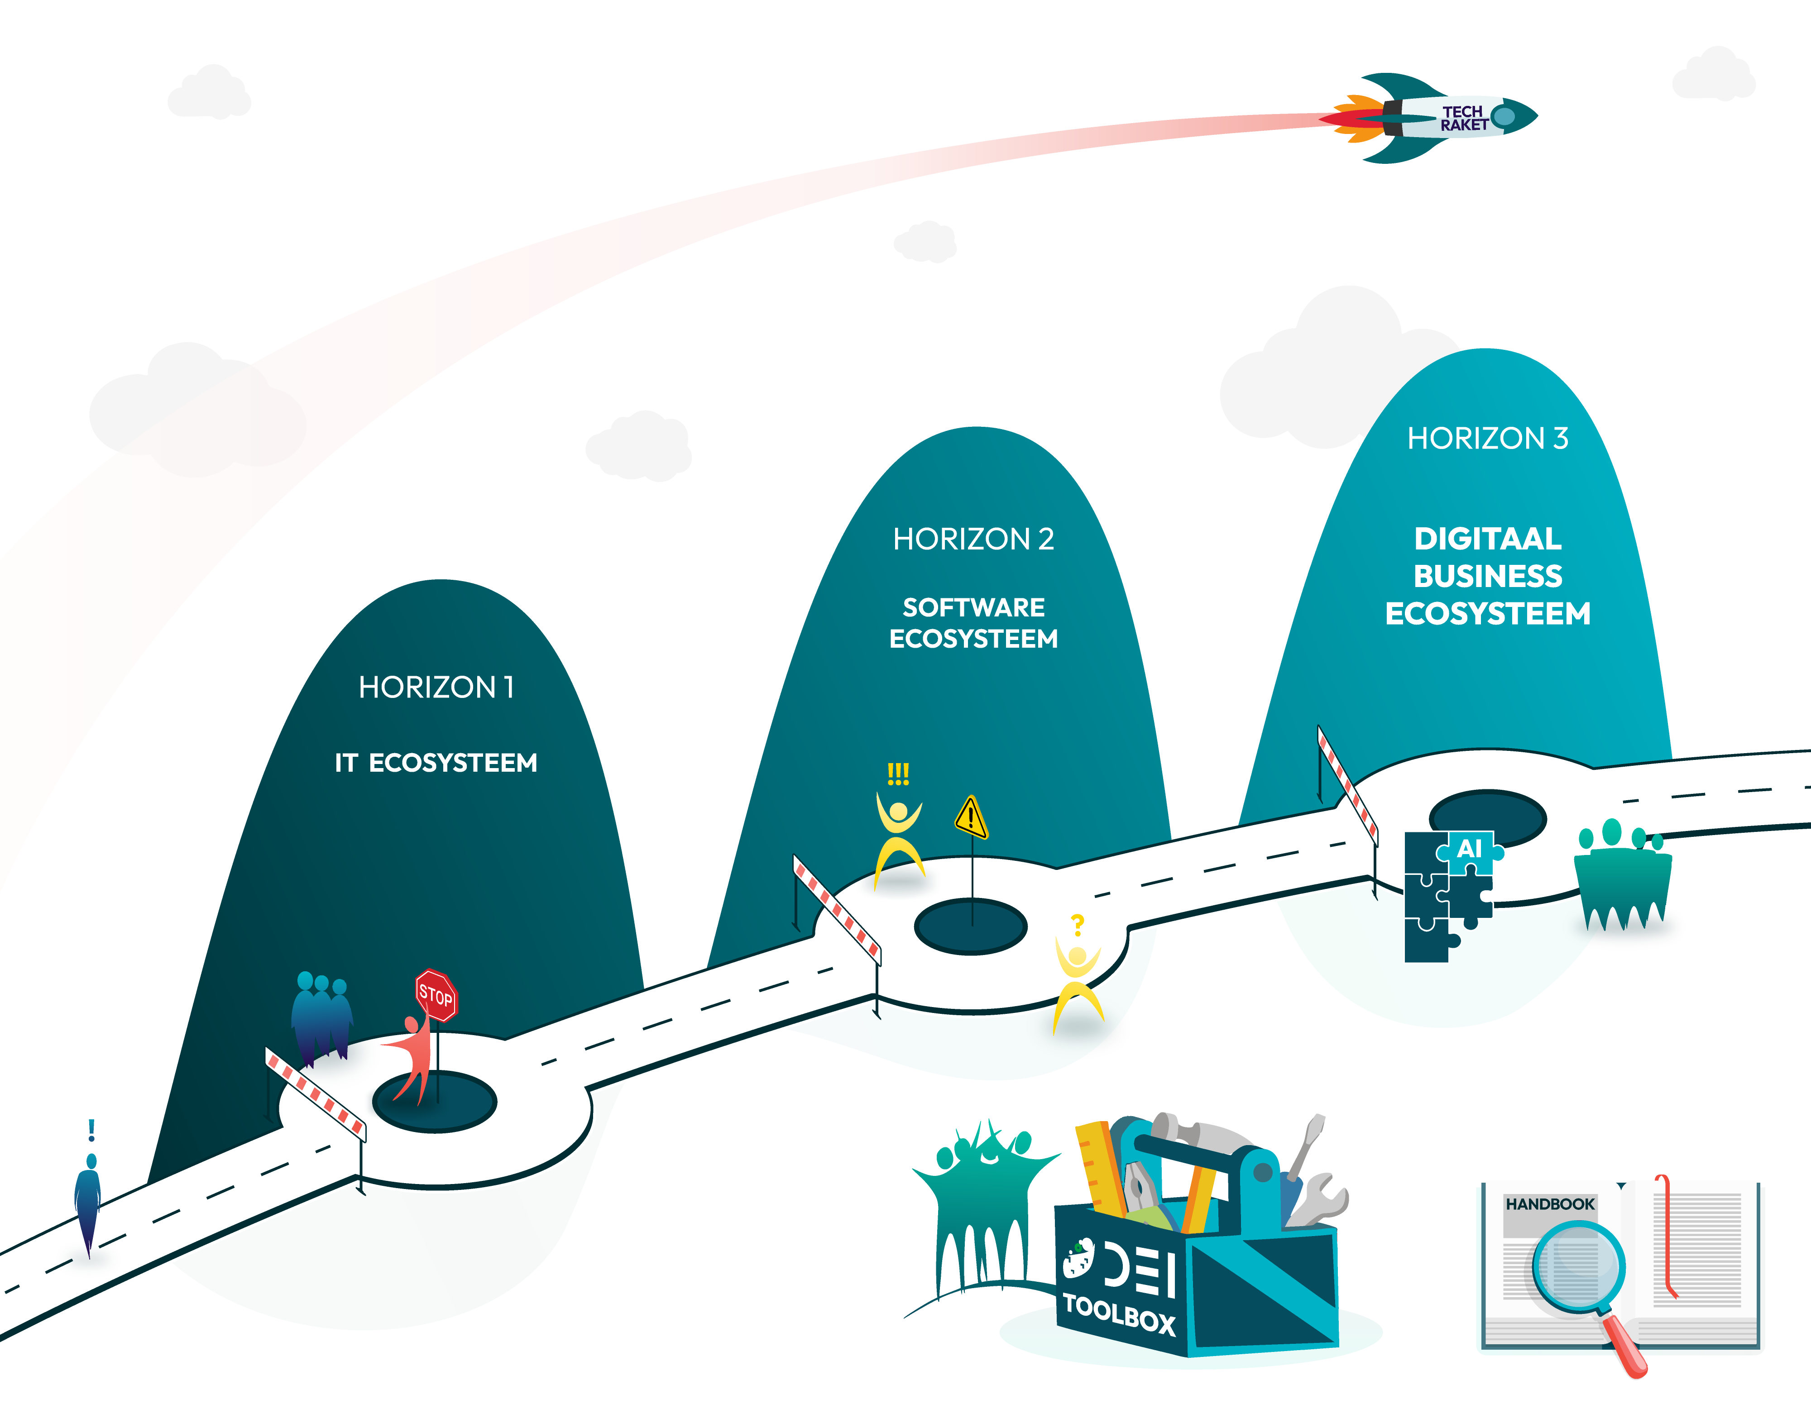
Digital Ecosystems Services Framework
Discover – Ecosystem Value – Ecosystem Horizon Model
1. Discover
Ecosystem value
Ecosystem Horizon Model
Link naar de presentatie

