Slide 1
PRESENTATIE
Digital Ecosytems Services Framework (Concept)
Versie: 20/2/2025

Slide 2
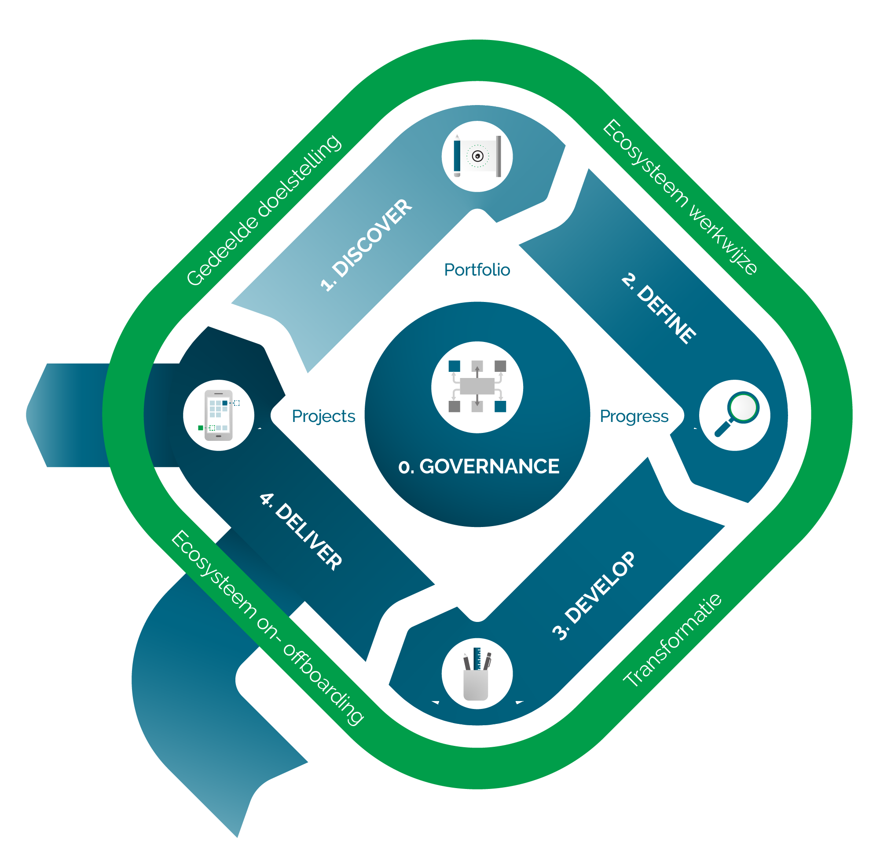
DEBB model

Slide 3
Digital Ecosystems Building Blocks (DEBB)
Guide
Orchestrate
Guide
Governance
Ecosystem service processes
Ecosystem policies
and regulation
Inter-organizational agreements
Collaborative
conditions
Partner On & offboarding
Collaborative fit monitoring
Co-evolution
monitoring
Guide
1. Discover
2. Define
3. Develop
4. Deliver
Guide
Strategy
The why of
ecosystems
Ecosystem vision and common goals
Code
of conduct
Partner
selection
Organisational
redesign
Investments
Ecosystem performance measurement
Forms of value co-creation
guide
Ecosystem organisational consensus
Value added services
of each partner
Guide
Partnership model
Ecosystem
Principles
Ecosystem
roles
Multidisciplinary
teams
Architecture
modelling
Ecosystem
Co-evolution
Ecosystem Service development
Seamless services
Innovation
Guide
Ecosystem
Value
Ecosystem Horizon Model
Ecosystem value proposition
Ecosystem business model
Ecosystem business case
Data space development
Platform development
Niche creation
Scale and monetize
Guide
Partner onboarding
Ecosystem boundaries
Composable service developmement
Guide
Composable capabilities
Ecosystem model canvas
Guide
Digital
platform
Ecosystem
legitimacy
Ecosystem organisation development
Value
optimisation

Slide 4
DEBB – DESF 1 Journey
Guide
Orchestrate
Guide
Governance
Ecosystem service processes
Ecosystem policies
and regulation
Inter-organizational agreements
Collaborative
conditions
Partner On & offboarding
Collaborative fit monitoring
Co-evolution
monitoring
Guide
1. Discover
2. Define
3. Develop
4. Deliver
Guide
Strategy
The why of
ecosystems
Ecosystem vision and common goals
Code
of conduct
Partner
selection
Organisational
redesign
Investments
Ecosystem performance measurement
Forms of value co-creation
guide
Ecosystem organisational consensus
Value added services
of each partner
Guide
Partnership model
Ecosystem
Principles
Ecosystem
roles
Multidisciplinary
teams
Architecture
modelling
Ecosystem
Co-evolution
Ecosystem Service development
Seamless services
Innovation
Guide
Ecosystem
Value
Ecosystem Horizon Model
Ecosystem value proposition
Ecosystem business model
Ecosystem business case
Data space development
Platform development
Niche creation
Scale and monetize
Guide
Partner onboarding
Ecosystem boundaries
Composable service developmement
Guide
Composable capabilities
Ecosystem model canvas
Guide
Digital
platform
Ecosystem
legitimacy
Ecosystem organisation development
Value
optimisation

Slide 5
DEBB – DESF 2 Journey
Guide
Orchestrate
Guide
Governance
Ecosystem service processes
Ecosystem policies
and regulation
Inter-organizational agreements
Collaborative
conditions
Partner On & offboarding
Collaborative fit monitoring
Co-evolution
monitoring
Guide
1. Discover
2. Define
3. Develop
4. Deliver
Guide
Strategy
The why of
ecosystems
Ecosystem vision and common goals
Code
of conduct
Partner
selection
Organisational
redesign
Investments
Ecosystem performance measurement
Forms of value co-creation
guide
Ecosystem organisational consensus
Value added services
of each partner
Guide
Partnership model
Ecosystem
Principles
Ecosystem
roles
Multidisciplinary
teams
Architecture
modelling
Ecosystem
Co-evolution
Ecosystem Service development
Seamless services
Innovation
Guide
Ecosystem
Value
Ecosystem Horizon Model
Ecosystem value proposition
Ecosystem business model
Ecosystem business case
Data space development
Platform development
Niche creation
Scale and monetize
Guide
Partner onboarding
Ecosystem boundaries
Composable service developmement
Guide
Composable capabilities
Ecosystem model canvas
Guide
Digital
platform
Ecosystem
legitimacy
Ecosystem organisation development
Value
optimisation

Slide 6
DEBB – DESF 3 Journey
Guide
Orchestrate
Guide
Governance
Ecosystem service processes
Ecosystem policies
and regulation
Inter-organizational agreements
Collaborative
conditions
Partner On & offboarding
Collaborative fit monitoring
Co-evolution
monitoring
Guide
1. Discover
2. Define
3. Develop
4. Deliver
Guide
Strategy
The why of
ecosystems
Ecosystem vision and common goals
Code
of conduct
Partner
selection
Organisational
redesign
Investments
Ecosystem performance measurement
Forms of value co-creation
guide
Ecosystem organisational consensus
Value added services
of each partner
Guide
Partnership model
Ecosystem
Principles
Ecosystem
roles
Multidisciplinary
teams
Architecture
modelling
Ecosystem
Co-evolution
Ecosystem Service development
Seamless services
Innovation
Guide
Ecosystem
Value
Ecosystem Horizon Model
Ecosystem value proposition
Ecosystem business model
Ecosystem business case
Data space development
Platform development
Niche creation
Scale and monetize
Guide
Partner onboarding
Ecosystem boundaries
Composable service developmement
Guide
Composable capabilities
Ecosystem model canvas
Guide
Digital
platform
Ecosystem
legitimacy
Ecosystem organisation development
Value
optimisation

Slide 7
DEBB – DESF Journeys
DESF 1
DESF 2
DESF 3
Guide
Orchestrate
Guide
Governance
Ecosystem service processes
Ecosystem policies
and regulation
Inter-organizational agreements
Collaborative
conditions
Partner On & offboarding
Collaborative fit monitoring
Co-evolution
monitoring
Guide
1. Discover
2. Define
3. Develop
4. Deliver
Guide
Strategy
The why of
ecosystems
Ecosystem vision and common goals
Code
of conduct
Partner
selection
Organisational
redesign
Investments
Ecosystem performance measurement
Forms of value co-creation
guide
Ecosystem organisational consensus
Value added services
of each partner
Guide
Partnership model
Ecosystem
Principles
Ecosystem
roles
Multidisciplinary
teams
Architecture
modelling
Ecosystem
Co-evolution
Ecosystem Service development
Seamless services
Innovation
Guide
Ecosystem
Value
Ecosystem Horizon Model
Ecosystem value proposition
Ecosystem business model
Ecosystem business case
Data space development
Platform development
Niche creation
Scale and monetize
Guide
Partner onboarding
Ecosystem boundaries
Composable service developmement
Guide
Composable capabilities
Ecosystem model canvas
Guide
Digital
platform
Ecosystem
legitimacy
Ecosystem organisation development
Value
optimisation

Slide 8
Digital Ecosystems Services Framework
Orchestrate
Uitleg
1. Discover
Uitleg
2. Define
Uitleg
4. Deliver
Uitleg

Slide 9
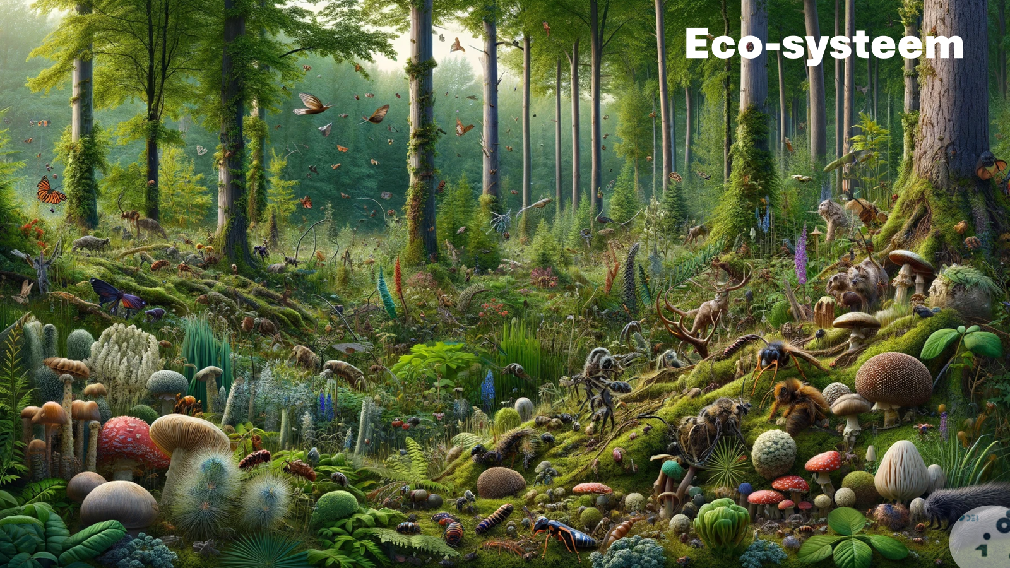
Digital Ecosystems Services Framework
Discover – Strategy – The why of ecosystems
1. Discover
Strategy
The why of
ecosystems
Korte toelichting bij doel van presentatie
Een inspirerend verhaal over ecosystemen laat zien waarom samenwerking krachtiger is dan individueel opereren. Het maakt de voordelen tastbaar, motiveert stakeholders en creëert een gedeelde visie. Mensen verbinden zich niet aan modellen of structuren, maar aan verhalen die laten zien hoe ecosystemen innovatie versnellen, problemen oplossen en impact vergroten.
Link naar de presentatie

Slide 10
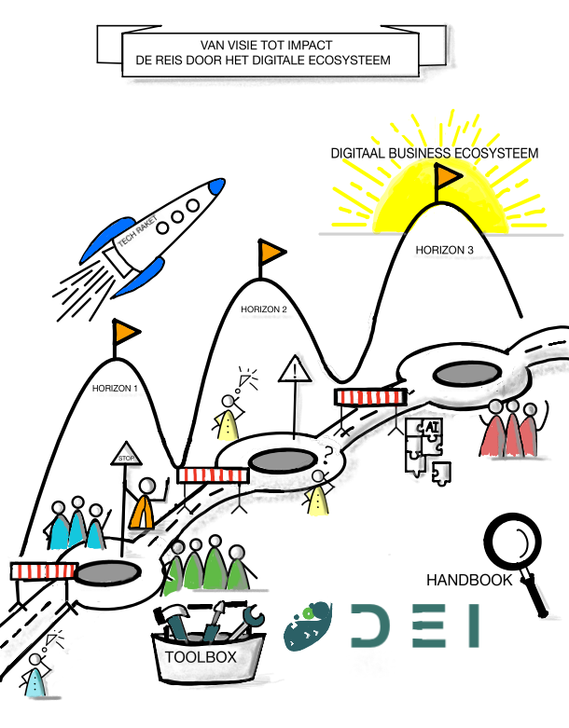
Digital Ecosystems Services Framework
Discover – Strategy – Ecosystem Horizon Model
1. Discover
Strategy
Ecosystem Horizon Model
De 3 horizonnen in de designfase van een ecosysteem
Horizon 1: IT Ecosysteem
Fase in design: Focus op stabiliteit en betrouwbaarheid van IT-infrastructuur.
Horizon 2: Software Ecosysteem
Fase in design: Meer focus op flexibiliteit en interoperabiliteit tussen organisaties.
Horizon 3: Digitaal Business Ecosysteem
Fase in design: Het ecosysteem wordt een strategisch samenwerkingsverband waarbij nieuwe businessmodellen ontstaan.
Gebruik het Horizon Model in de designfase door eerst te bepalen in welke horizon de organisaties zich bevinden en welke digitale transformatie gewenst is. Ontwerp vervolgens de architectuur en governance op basis van de gekozen horizon en zorg voor een flexibel groeipad om samenwerking en innovatie te faciliteren.
Link naar de presentatie

Slide 11


Dank je wel!
Wil je meer weten? Neem contact met ons op: XX

